Slide 1

Including regime shifts in fisheries assessments and harvest recommendations using Markov switching models
Gavin Fay
gfay@umassd.edu
@gavin_fay
www.thefaylab.com
Acknowledgements
Jim Thorson (NOAA-NWFSC)
Cody Szuwalski (UC Santa Barbara)
Curry Cunningham (U Washington)
DFO Seminar: 15th October 2014

Slide 2
Seminar outline
Regime shifts in Marine Ecosystems
Providing management advice with regimes
Markov switching models (or HMMs)
Estimating regime shifts using HMMs
Application to New England fisheries
Extensions to the approach
Further work

Slide 3
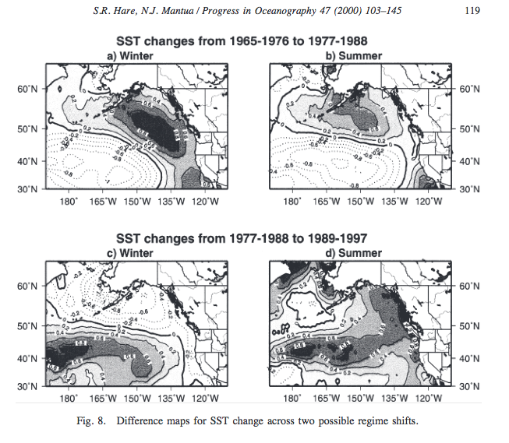
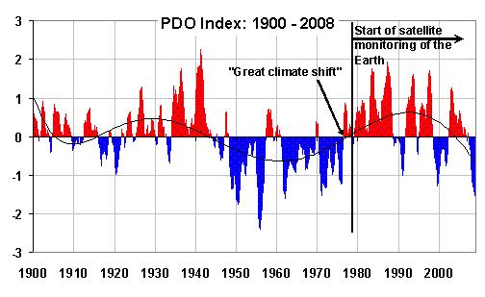
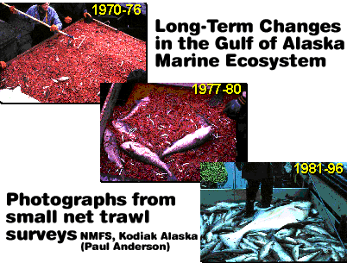
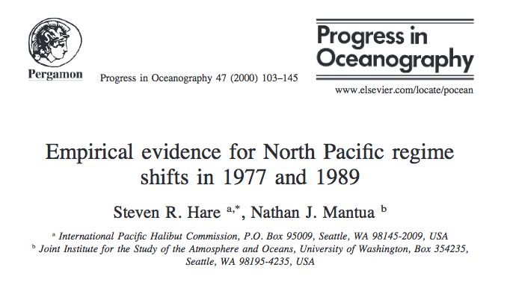
Regime Shifts
Ubiquitous in the ecological and fisheries literature

Slide 4
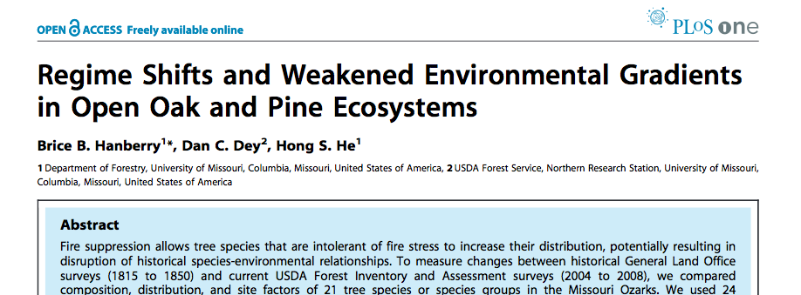



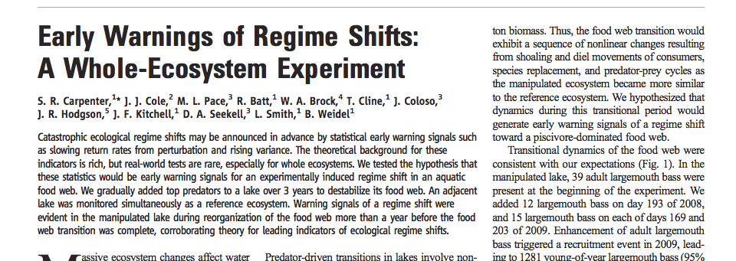
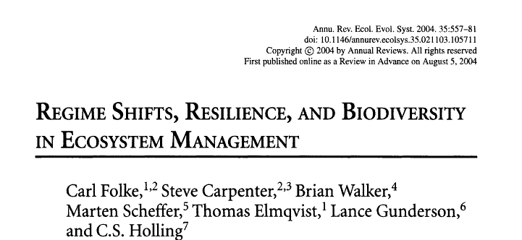
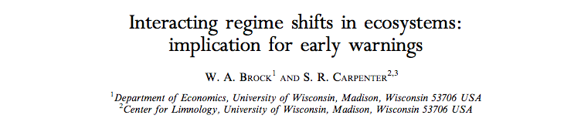
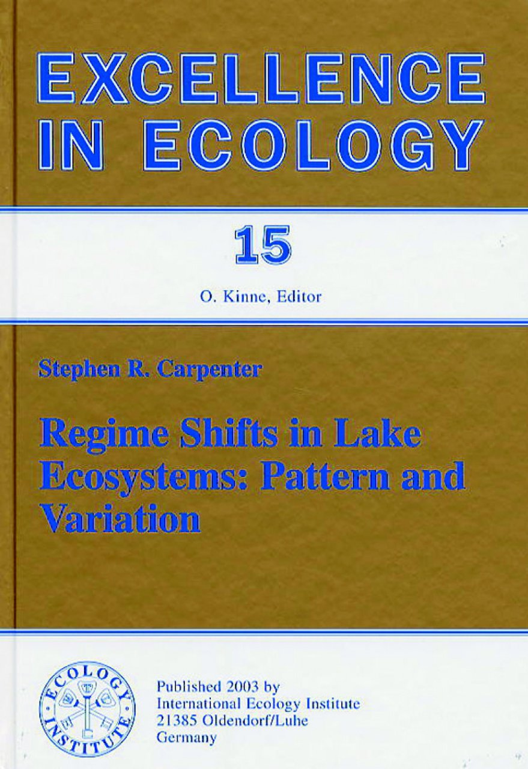

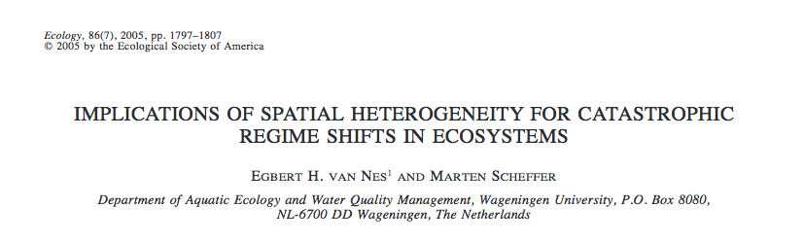

Slide 5
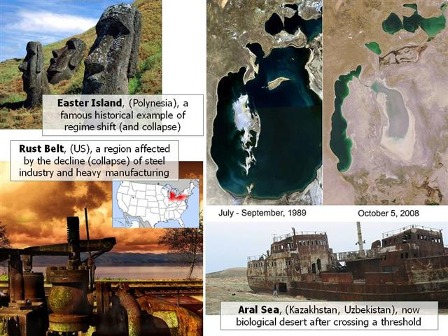
http://www.responsiblebusiness.eu/display/rebwp2/Resilience+thinking

Slide 6
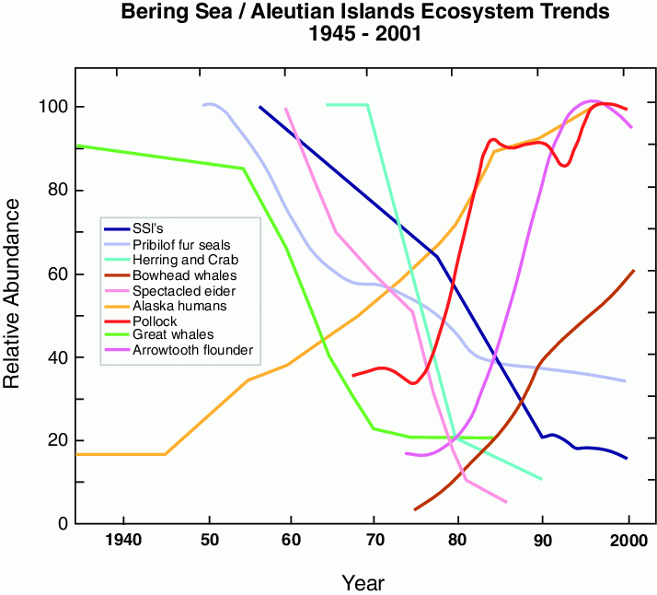
Stabeno et al. 2005, after NRC 2003

Slide 7
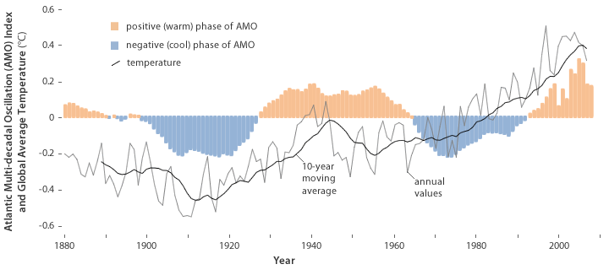
Atlantic Multi-decadal Oscillation
http://www.climatewatch.noaa.gov/

Slide 8
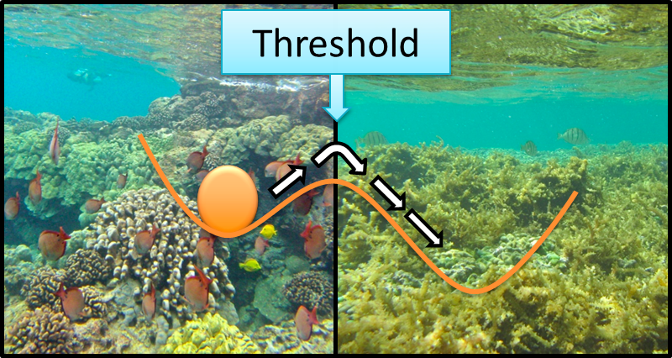
What is a regime shift?
Regime shift: Rapid reorganization of a system from one relatively unchanging state to another. (Carpenter and Folke 2006)
www.oceantippingpoints.org

Slide 9
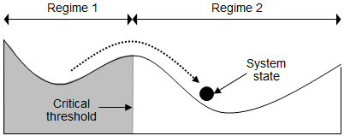
What is a regime shift?
Regime shift: Rapid reorganization of a system from one relatively unchanging state to another. (Carpenter and Folke 2006)
http://www.regimeshifts.org/what-is-a-regime-shift

Slide 10
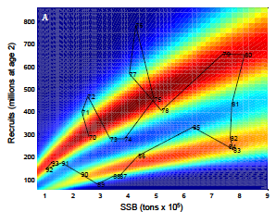
Pacific Sardine recruitment
Munch et al. Environmental regimes and density-dependence: a Bayesian modeling approach for identifying recruitment regimes.

Slide 11
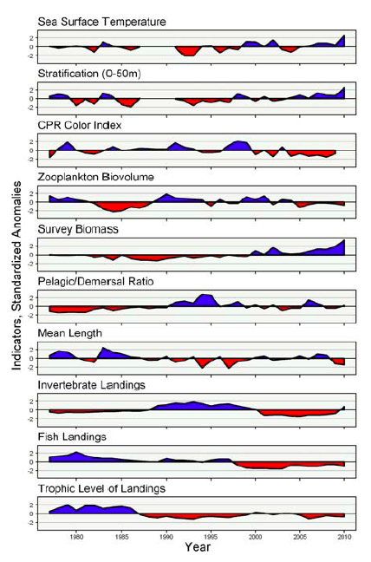
Gulf of Maine Ecosystem indicators

Slide 12
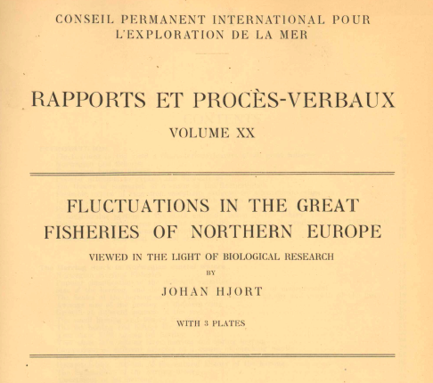
Productivity shifts in marine fish
Hjort 1914

Slide 13
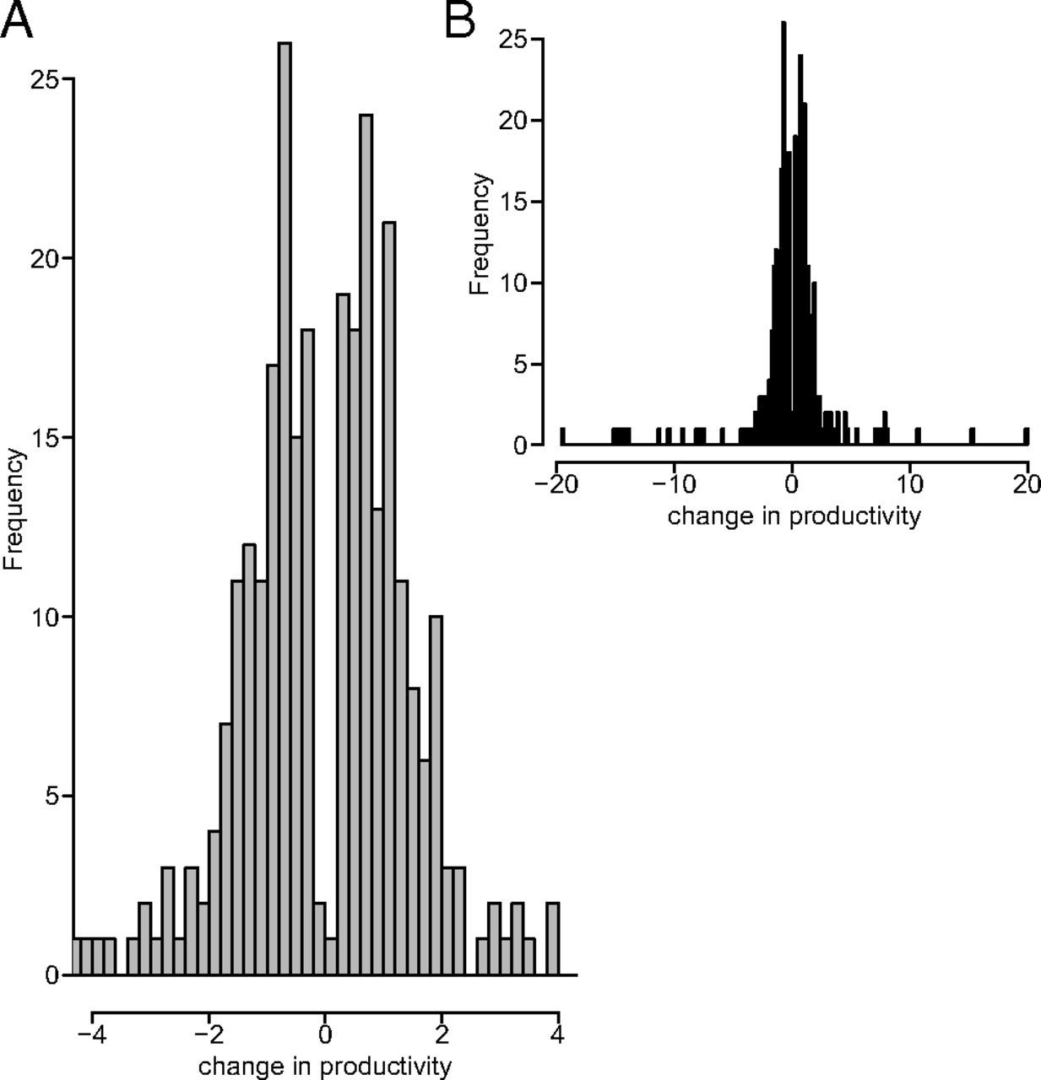
Productivity shifts in marine fish
Common
High in magnitude
Vert-pre K A et al. PNAS 2013;110:1779-1784
©2013 by National Academy of Sciences
Notes:
Frequency distribution of shifts in production. (A) Shifts are plotted in the range from −4 to 4, which excludes some extreme values. (B) Shifts are plotted in the range from −20 to 20 and include all outliers.

Slide 14
Including regime Shifts in fisheries management
Less ubiquitous
Changes in productivity associated with regimes
Challenges for management:
(a) how to allocate regime membership for forecast years,
(b) whether to specify regime-driven changes in biological reference points, and
(c) how to determine catch advice for forecast years.

Slide 15
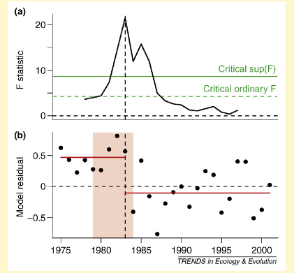

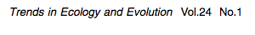
Change-point analysis to identify regime shifts

Slide 16
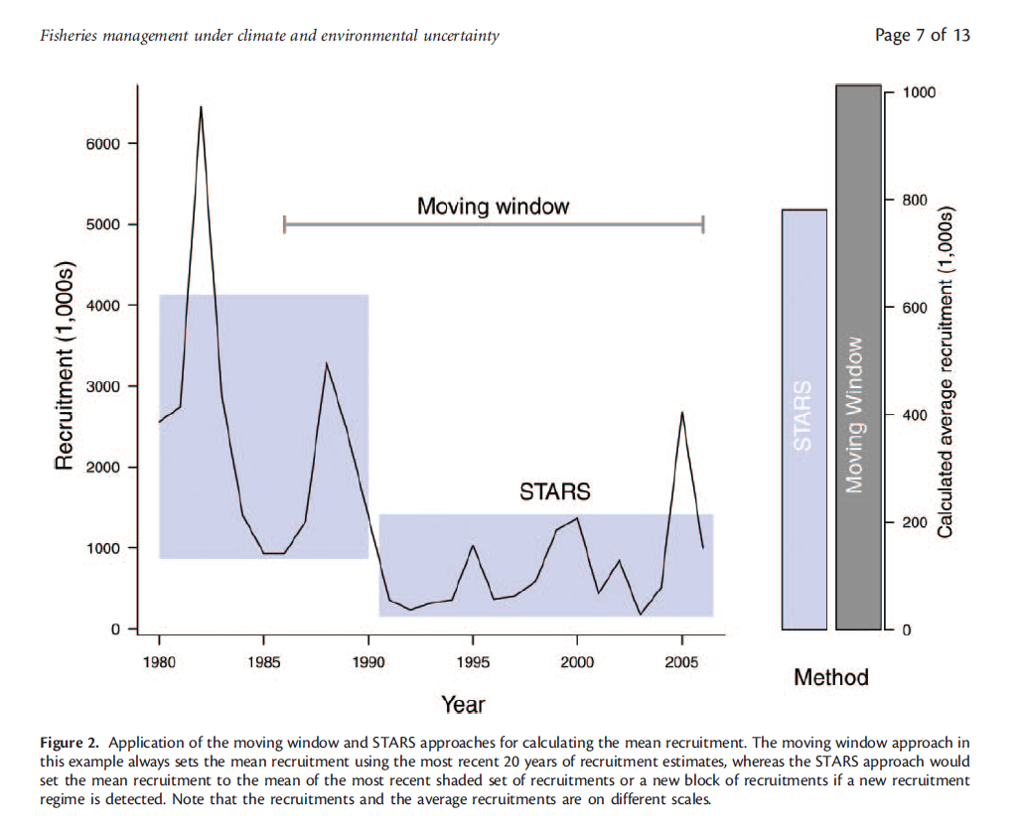
Punt et al. 2013

Slide 17
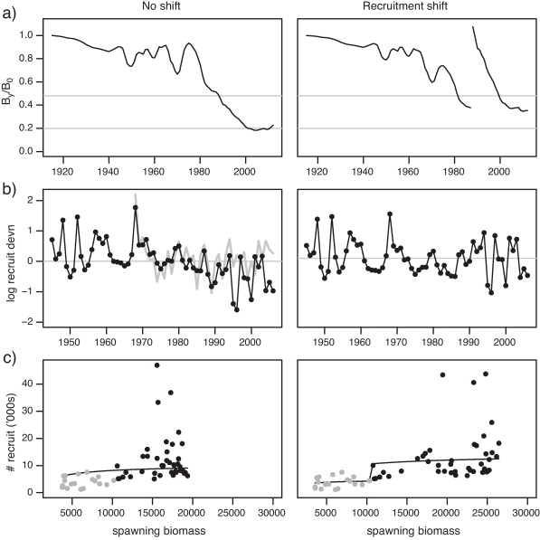
Sally E. Wayte
Management implications of including a climate-induced recruitment shift in the stock assessment for jackass morwong ( Nemadactylus macropterus ) in south-eastern Australia
Fisheries Research, Volume 142, 2013, 47 - 55
http://dx.doi.org/10.1016/j.fishres.2012.07.009

Slide 18
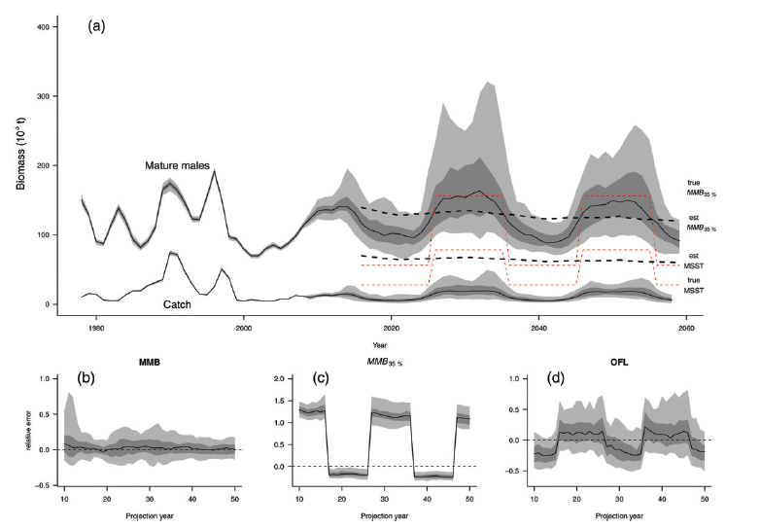
Bering Sea snow crab: evaluating regime-based control rules

Slide 19
Some thoughts ….
Regime determination often post-analysis (not part of estimation)
Management advice determined based on whether to accept one regime or not. (i.e. you know which regime you will be in).
Unless the control rule includes regime allocation, when do you make a decision to adopt the new regime?
Does your policy allow for going back?

Slide 20
More thoughts….
Can we account for uncertainty in regime membership for advice years?
Do state-transition models such as Markov switching models (or Hidden Markov models) offer a solution?
Assume regime dynamics evolve over time according to Markov chain.
estimate probabilities for transition among regimes,
productivity parameters associated with each regime,
estimate probabilities for regime membership for the terminal year, determine catch advice.

Slide 21
Markov switching models (HMMs)
Developed for speech recognition, used in finance and econometrics.
Application in ecology largely associated with movement and behavioral modeling
Same dependence structure as state-space models.
Notes:
Belong to class of dependent mixture models
Same dependence structure as state-space models, but assume a finite number of states.
Incorporate presence of underlying state, along with autocorrelation, and facilitate inference.

Slide 22
Hidden Markov Modeling
high
Productivity Regime
low
Time
t = 0

Slide 23
Hidden Markov Modeling
high
Productivity Regime
low
Time
t = 0
t = 1

Slide 24
Hidden Markov Modeling
high
Productivity Regime
low
Time
t = 0
t = 1
t = 2

Slide 25
Hidden Markov Modeling
high
Productivity Regime
?
low
Time
t = 0
t = 1
t = 2
t = 3

Slide 26
Hidden Markov Modeling
high
Productivity Regime
?
low
Time
t = 0
t = 1
t = 2
t = 3

Slide 27

Hidden Markov Modeling
Fish population
?
high
Productivity Regime
?
low
Time
t = 0
t = 1
t = 2
t = 3

Slide 28

Hidden Markov Modeling
Observations
Fish population
?
high
Productivity Regime
?
low
Time
t = 0
t = 1
t = 2
t = 3

Slide 29
Hidden Markov Modeling
Observations
Fish population
?
high
Productivity Regime
?
low
Time
t = 0
t = 1
t = 2
t = 3

Slide 30
Hidden Markov Modeling
Observations
Fish population
?
high
Productivity Regime
?
low
Time
t = 0
t = 1
t = 2
t = 3

Slide 31
Estimate probability of regime membership over time
State at t+1 dependent on state at time t and the transition probabilities
1
1
2
2

Slide 32
Management advice
Project Markov chain for an additional year
Calculate posterior distribution for u_{MSY} given probabilities of membership in each regime.
Apply to model biomass estimate to obtain next year’s catch under the regime-dependent MSY exploitation rate.

Slide 33
Application: biomass dynamic model with regime switching in population growth rate
Assume intrinsic growth rate follows regimes
Additional parameters: extra r’s, transition probabilities, regime state distribution in initial year.

Slide 34
Application: New England groundfish
Models fit using JAGs
Fit to fall survey biomass data (1963-) and catches (totals from most recent assessment docs)
Fit models with no regimes, and 2 or three regimes.

Slide 35
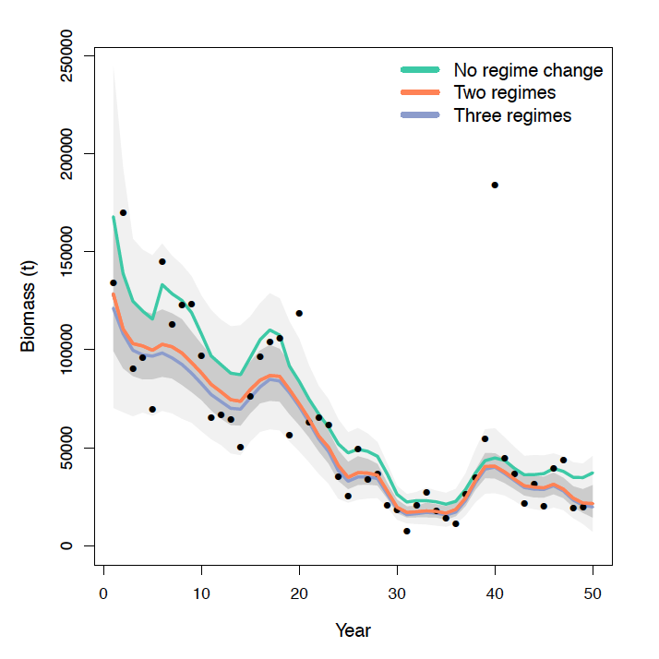
Gulf of Maine cod: fit to fall biomass survey

Slide 36
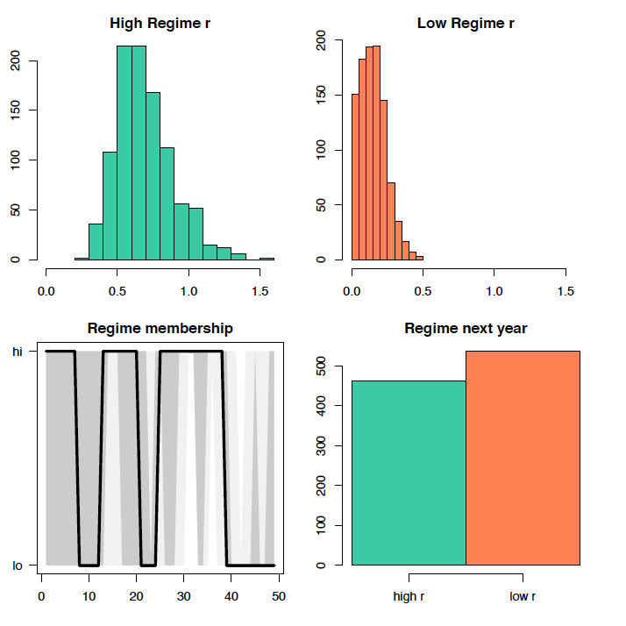
Gulf of Maine cod: Two regimes

Slide 37
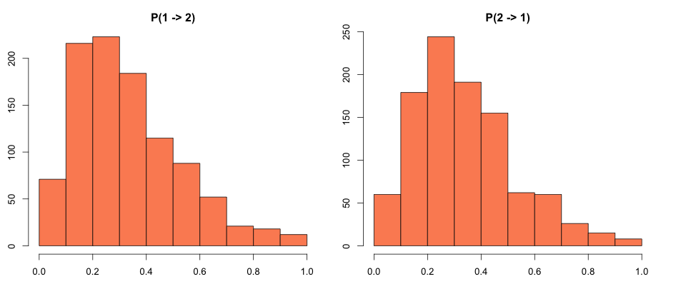
Regime transition probabilities Gulf of Maine cod

Slide 38
Model selection: DIC results
 | No regimes | 2 regimes | 3 regimes
GB cod | 259.39 | 251.50 | 250.09
GOM haddock | 183.43 | 189.68 | 189.17
GB Yellowtail flounder | 589.43 | 587.51 | 587.03
SNE Winter flounder | 102.48 | 82.65 | 82.66
GOM cod | 337.75 | 224.44 | 343.29
DIC references:
1. Gelman, Andrew; Carlin, John B.; Stern, Hal S.; Rubin, Donald B. (2004). Bayesian Data Analysis: Second Edition. Texts in Statistical Science. CRC Press. ISBN 1-58488-388-X.
2. Spiegelhalter, David J.; Best, Nicola G.; Carlin, Bradley P.; van der Linde, Angelika (October 2002). "Bayesian measures of model complexity and fit (with discussion)". Journal of the Royal Statistical Society, Series B 64 (4): 583–639. doi:10.1111/1467-9868.00353.

Slide 39
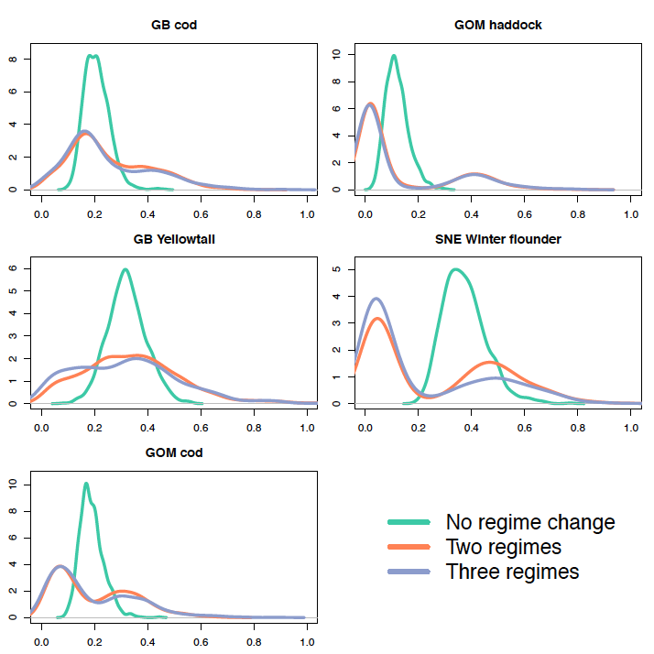
MSY exploitation rate next year

Slide 40
Catch (t) next year under u_{MSY} [posterior median]
 | No regimes | 2 regimes | 3 regimes
GB cod | 17,523 | 11,702 | 9,543
GOM haddock | 248 | 22 | 15
GB Yellowtail flounder | 17,799 | 19,239 | 19,639
SNE Winter flounder | 17,568 | 3,829 | 1,497
GOM cod | 6,778 | 3,304 | 2,478

Slide 41
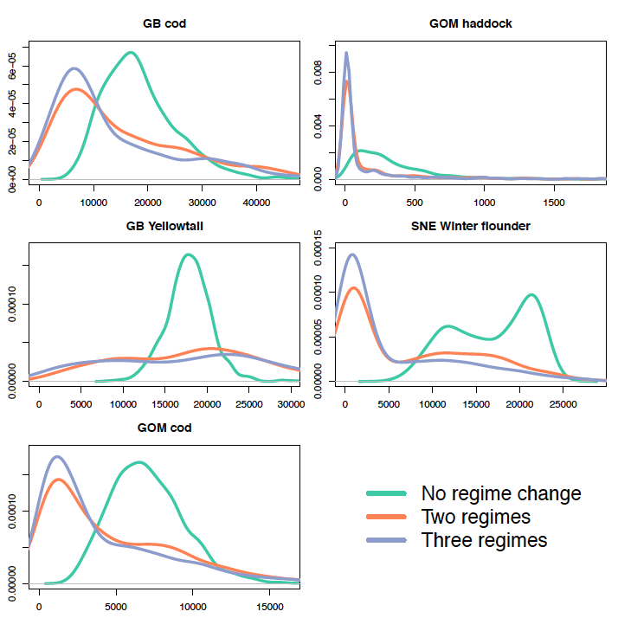
u_{MSY} catch next year

Slide 42
Results summary
Models with regime switches better fits in some cases.
Ability to distinguish among # of regimes challenging.
Including regimes can substantially change harvest recommendations.

Slide 43
Extensions & Further work
Include HMM in age-structured models
Multi-species
Time-dependent transition probabilities
Simulation testing
What happens when we fit a model with regimes to data generated from a model without regime shifts?
Compare with alternatives (STARS-based HCRs, dynamic B0), e.g. through MSE

Slide 44
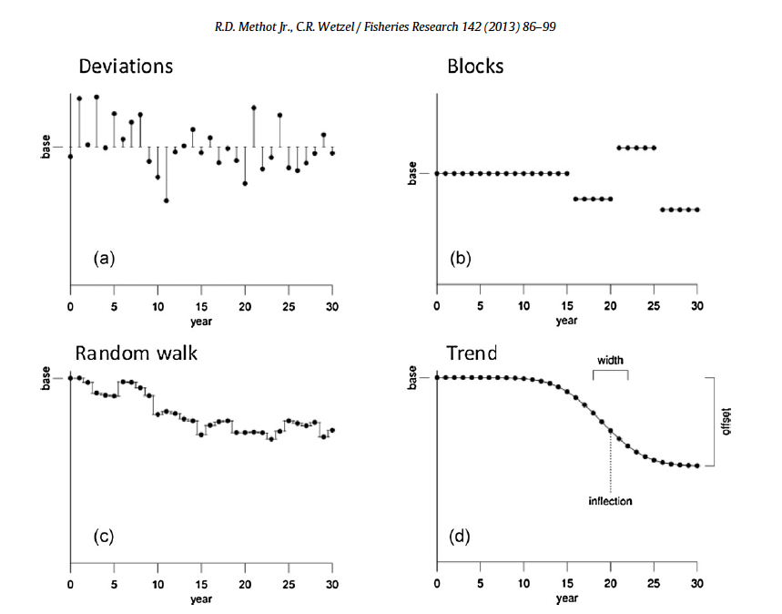
Time-varying parameters in stock assessment
Markov switching just one example to implement time-varying process

Slide 45
Take Home Messages
Regime shifts are common, we need to understand how robust our scientific and management tools are to them.
Markov Switching models provide a pathway for estimating regimes and integrating uncertainty into fisheries policy.
Harvest policy will differ when based on regime shifts: important to understand consequences of adopting these approaches.

Slide 46

Thank you
gfay@umassd.edu
github.com/gavinfay/regimeswitch
www.thefaylab.com
@gavin_fay

Slide 47
Some suggested reading
A'mar, Z. T., Punt, A. E., & Dorn, M. W. (2009). The impact of regime shifts on the performance of management strategies for the Gulf of Alaska walleye pollock (Theragra chalcogramma) fishery. Canadian Journal of Fisheries and Aquatic Sciences, 66(12), 2222-2242.
Biggs, R., Blenckner, T., Folke, C., Gordon, L.J., Norström, A., Nyström, M., Peterson, G.D.,2012. Regime shifts. In: Hastings, A., Gross, L. (Eds.), Encyclopedia of Theoretical Ecology. University of California Press.
Punt, A. E., A’mar, T., Bond, N. A., Butterworth, D. S., de Moor, C. L., De Oliveira, J. A. Fisheries management under climate and environmental uncertainty: control rules and performance simulation. – ICES Journal of Marine Science, doi:10.1093/icesjms/fst057.. A., Haltuch, M. A., Hollowed, A. B., and Szuwalski, C
Szuwalski, C., and Punt A. E. 2013. Fisheries management for regime-based ecosystems: a management strategy evaluation for the snow crab fishery in the eastern Bering Sea. – ICES Journal of Marine Science, 70: 955–967.
Szuwalski, C. S., Vert‐Pre, K. A., Punt, A. E., Branch, T. A., & Hilborn, R. (2014). Examining common assumptions about recruitment: a meta‐analysis of recruitment dynamics for worldwide marine fisheries. Fish and Fisheries.
Vert-pre, K. A., Amoroso, R. O., Jensen, O. P., & Hilborn, R. (2013). Frequency and intensity of productivity regime shifts in marine fish stocks. Proceedings of the National Academy of Sciences, 110(5), 1779-1784.
Wayte, S. E. (2012). Management implications of including a climate-induced recruitment shift in the stock assessment for jackass morwong (Nemadactylus macropterus) in south-eastern Australia. Fisheries Research.

Slide 48
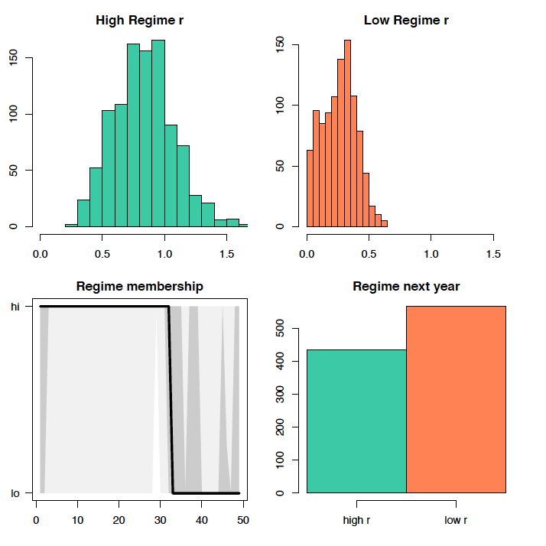
Georges Bank cod: Two regimes

Slide 49
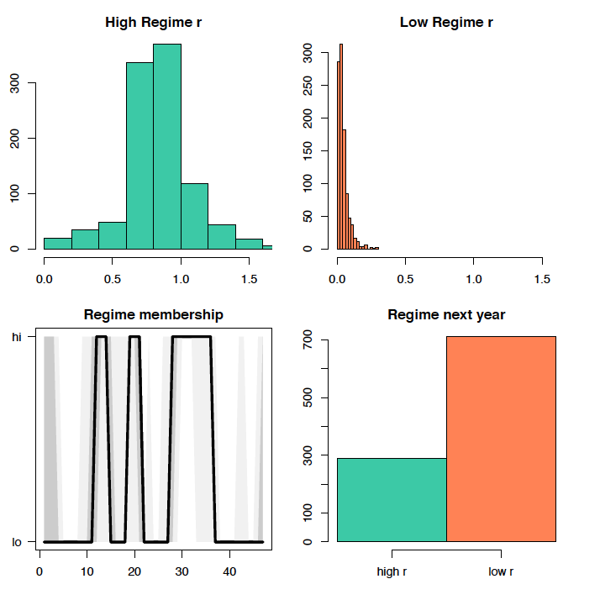
Gulf of Maine haddock: Two regimes

Slide 50
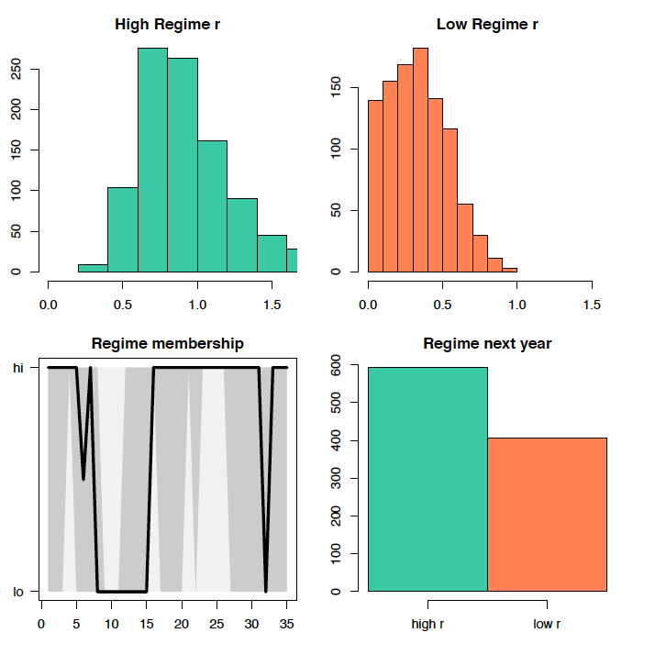
Georges Bank Yellowtail: Two regimes

Slide 51
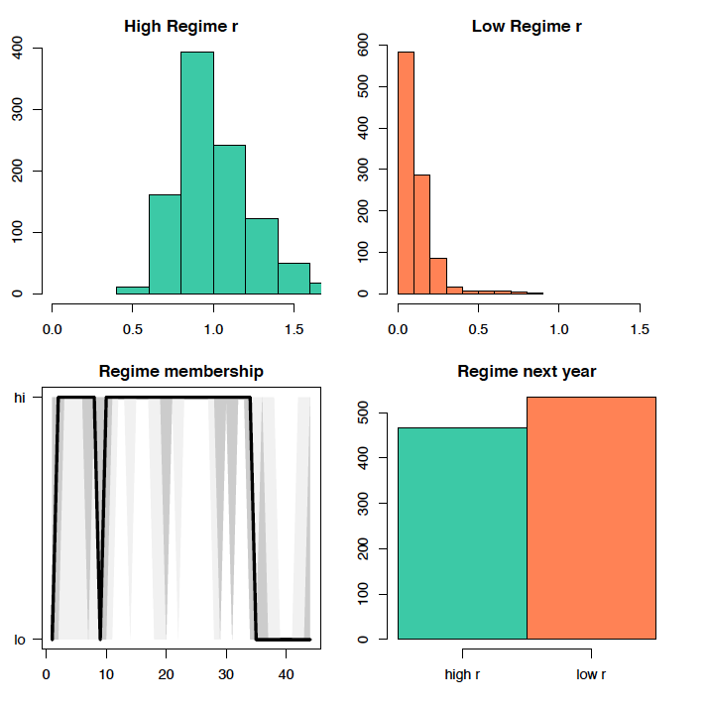
SNE winter flounder: Two regimes

Slide 52
Estimation
P(Regime=m) can be decomposed into prior information both forwards and backwards in time (‘forwards-backwards’ algorithm).
Not trivial when also coinciding with evolution of a continuous state variable.
Other ML options, Kalman filter approximation, EM algorithm.
Or, treat the states as discrete parameters

Slide 53
Application: Schaefer model with regimes in r
Assume intrinsic growth rate follows regimes
Additional parameters: extra r, transition probabilities (2), Regime state distribution in initial year.

Slide 54
Marginal state-space / HMM likelihood

